Slide 1
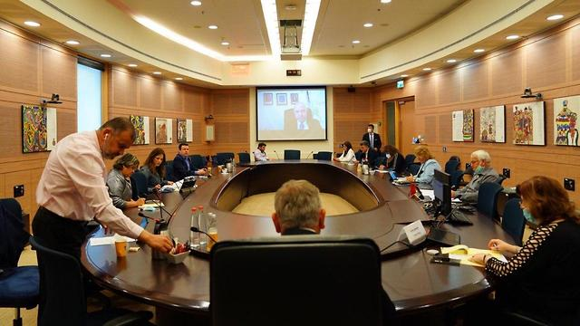
Gender Bias In The Knesset Committees
Digital Humanities Project

Slide 2
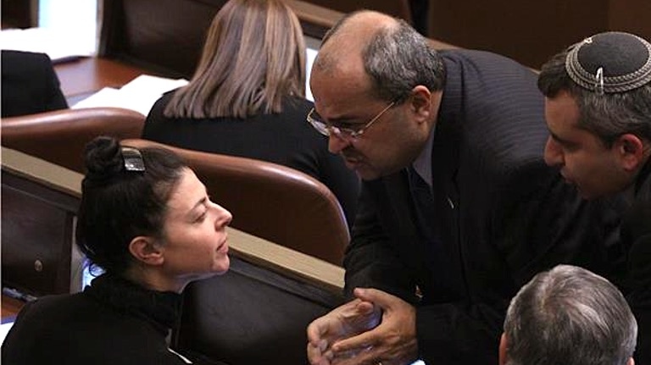
Project Goal
Our goal in this project is to check equality/inequality in the Knesset Committees. We are seeking to see if women has the same space to speak as men in the committees.

Slide 3
Digital Humanities?
Since there is a serious social struggle with freedom of speech of women in many fields in the community, we want to see if the Knesset gives women the same space to speak as it gives the men.
In this project we will be working with big messy data which will force us to find new mechanisms to work with it and reach the desired information.

Slide 4
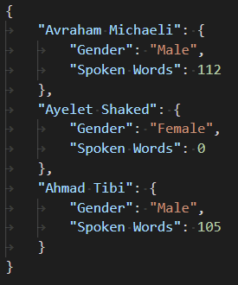
Working Flow
We are going to sample a large amount of the Knesset committees that contains representation from both genders.
For each committee we will analyze it by counting the words spoken by each participant, using an automated script in python.
For each committee we will build a JSON file, which contains objects representing the results of the analyze.

Slide 5
Working Flow Cont.
We will create a dataset that contains all the information we collect and analyze about each committee.
According to the results we will create a visualization representing these results.
We will supply the user with API to access the data our project provides, like JSON files for each committee and the dataset we will create.

Slide 6
Resources
Knesset committees website: https://main.knesset.gov.il/Activity/committees/Pages/AllCommitteeProtocols.aspx?ItemID=2019055
Knesset members dataset: https://opendata.hasadna.org.il/dataset/Knesset-members/resource/738b6353-a5c8-44fa-bf9e-cc5ef6a4f9a9

